Slide 1



BTPN Syariah
Data Engineer Virtual Internship Program – February 2023
Enhancing Business Performance through
Customer Segmentation Analysis
By Adrian Maulana Muhammad
https://github.com/adrn-mm/final-project-VIX-DE-BTPN

Slide 2

Table of Contents
Business Understanding
1.
Data Understanding
2.
3.
Extract, Transform, and Load Process
4.
Customer Segmentation Analysis
Summaries
5.
Recommendations
6.
References
7.

Slide 3

Business Understanding

Slide 4

Background
The bank intends to enhance its business performance by using historical customer data to develop better marketing strategies. To accomplish this objective, the bank must comprehend its customers' attributes and pinpoint opportunities for increasing sales of additional products to existing customers.

Slide 5
Problem Description
Based on the previously mentioned background, I have concluded the main problem for this project as follows:
The bank needs to utilize its historical customer data to segment customers into more targeted groups, helping it develop more effective marketing and selling strategies.

Slide 6
Business Objectives
Based on the background explanation and problem description, I have formulated a business objective for this project:
Conduct segmentation analysis by dividing customers into different groups based on their characteristics, such as customer status, age, gender, education, marital status, number of dependents, income, and type of credit card used. This will help the bank understand its customers better and develop more effective marketing strategies.

Slide 7
Data Understanding

Slide 8
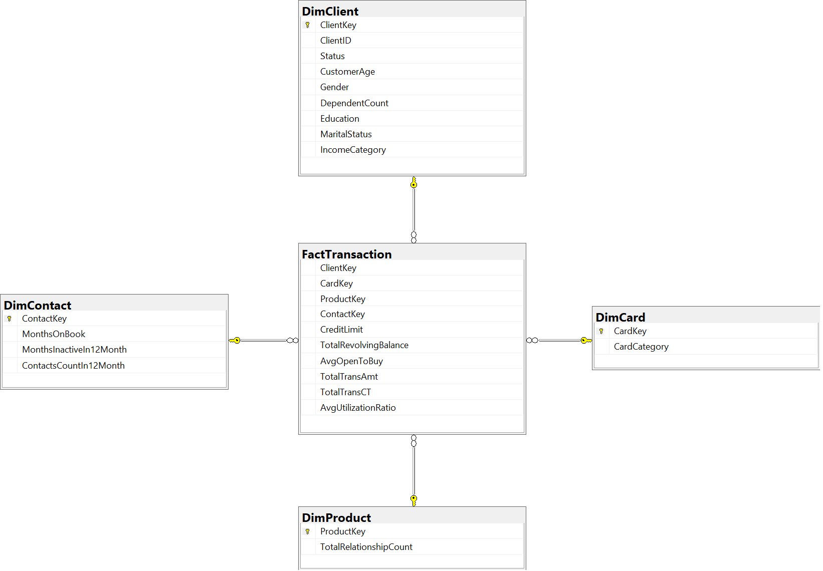
Data Model

Slide 9
Data Summaries
Table | Summary
FactTransaction | The transaction data and related information, such as the client, card, product, and contact involved in each transaction.
DimClient | Information about the clients, such as their key, name, age, gender, education level, marital status, income category, and dependent count.
DimCard | Information about the credit cards, such as their key, category, and type.
DimContact | Information about the contact channels, such as their key, inactive months in 12 months, contact count in 12 months, and months on book.
DimProduct | information about the bank products, such as their key, type, and total relationship count.

Slide 10
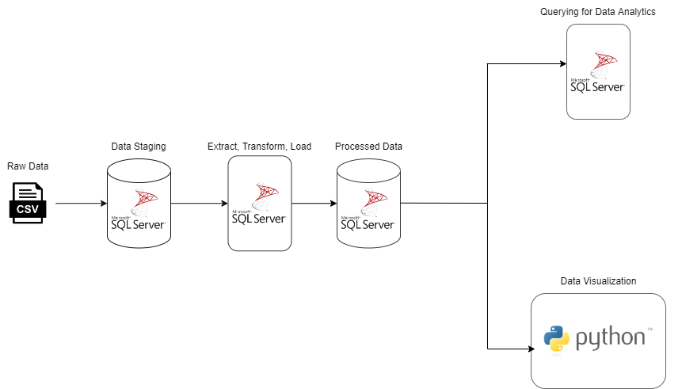
Data Pipeline

Slide 11
Extract, Transform, and Load Process

Slide 12
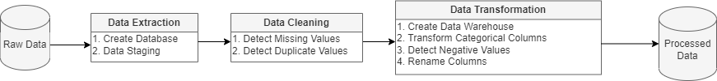
ETL Process Pipeline

Slide 13
Data Extraction Queries
Data Staging
-- use the database
USE CustomerHistoryData;
-- create a new table
CREATE TABLE dbo.DataStaging(
CLIENTNUM int,
idstatus int,
Customer_Age int,
Gender varchar(255),
Dependent_count int,
Educationid int,
Maritalid int,
Income_Category varchar(255),
Card_Category int,
Months_on_book int,
Total_Relationship_Count int,
Months_Inactive_12_mon int,
Contacts_Count_12_mon int,
Credit_Limit float,
Total_Revolving_Bal int,
Avg_Open_To_Buy float,
Total_Trans_Amt int,
Total_Trans_Ct int,
Avg_Utilization float
);
-- import the file
BULK
INSERT dbo.DataStaging
FROM ‘path\customer_data_history.csv' WITH(FORMAT = 'CSV', FIRSTROW = 2);
Create Database
-- create a new database for this project
CREATE DATABASE CustomerHistoryData;

Slide 14
Data Cleaning Queries
Detect Missing Values
-- use the database
USE CustomerHistoryData;
-- Checking for missing values in the primary key in the data staging table
SELECT *
FROM dbo.DataStaging
WHERE CLIENTNUM IS NULL;
Detect Duplicate Values
-- use the database
USE CustomerHistoryData;
-- Checking duplicate values in the primary key in the data staging table
SELECT CLIENTNUM,
COUNT(CLIENTNUM)
FROM dbo.DataStaging
GROUP BY CLIENTNUM
HAVING COUNT(CLIENTNUM) > 1

Slide 15
Data Transformation Queries - 1
Detect Negative Values
-- use the database
USE CustomerHistoryData -- detect the negative values
SELECT COUNT(*) AS TotalNegativeRows
FROM dbo.DataWarehouse
WHERE Months_on_book < 0
OR Total_Relationship_Count < 0
OR Months_Inactive_12_mon < 0
OR Contacts_Count_12_mon < 0
OR Credit_Limit < 0
OR Total_Revolving_Bal < 0
OR Avg_Open_To_Buy < 0
OR Total_Trans_Amt < 0
OR Total_Trans_Ct < 0
OR Avg_Utilization < 0;
Create Data Warehouse
-- use the database
USE CustomerHistoryData;
-- create a new table (data warehouse)
SELECT * INTO dbo.DataWarehouse
FROM dbo.DataStaging;

Slide 16
Data Transformation Queries - 2
Transform Categorical Columns (2)
-- use the database
USE CustomerHistoryData
-- transform categorical data
UPDATE dbo.DataWarehouse
SET Idstatus = CASE
WHEN Idstatus = 1 THEN 'Existing Customer'
WHEN Idstatus = 2 THEN 'Attrited Customer'
ELSE 'Unknown'
END,
Customer_Age = CASE
WHEN Customer_Age < 30 THEN '20s'
WHEN Customer_Age >= 30
AND Customer_Age < 40 THEN '30s'
WHEN Customer_Age >= 40
AND Customer_Age < 50 THEN '40s'
WHEN Customer_Age >= 50
AND Customer_Age < 60 THEN '50s'
WHEN Customer_Age >= 60
AND Customer_Age < 70 THEN '60s'
WHEN Customer_Age >= 70 THEN '70s+'
ELSE 'Unknown'
END,
Educationid = CASE
WHEN Educationid = 1 THEN 'High School'
WHEN Educationid = 2 THEN 'Graduate'
WHEN Educationid = 3 THEN 'Uneducated'
WHEN Educationid = 4 THEN 'Unknown'
WHEN Educationid = 5 THEN 'College'
WHEN Educationid = 6 THEN 'Post-Graduate'
WHEN Educationid = 7 THEN 'Doctorate'
ELSE 'Unknown'
END;
Transform Categorical Columns (1)
-- use the database
USE CustomerHistoryData;
-- change table column's data type before transforming
ALTER TABLE dbo.DataWarehouse
ALTER COLUMN Idstatus VARCHAR(255);
ALTER TABLE dbo.DataWarehouse
ALTER COLUMN Customer_Age VARCHAR(255);
ALTER TABLE dbo.DataWarehouse
ALTER COLUMN Educationid VARCHAR(255);
ALTER TABLE dbo.DataWarehouse
ALTER COLUMN Maritalid VARCHAR(255);
ALTER TABLE dbo.DataWarehouse
ALTER COLUMN Card_Category VARCHAR(255);
ALTER TABLE dbo.DataWarehouse
ALTER COLUMN Dependent_count VARCHAR(255);

Slide 17
Data Transformation Queries - 3
Rename Columns (1)
-- Use the database you want to work with
USE CustomerHistoryData;
-- Rename the columns
EXEC sp_rename 'dbo.DataWarehouse.CLIENTNUM',
'ClientID',
'COLUMN';
EXEC sp_rename 'dbo.DataWarehouse.idstatus',
'Status',
'COLUMN';
EXEC sp_rename 'dbo.DataWarehouse.Customer_Age',
'CustomerAge',
'COLUMN';
EXEC sp_rename 'dbo.DataWarehouse.Dependent_count',
'DependentCount',
'COLUMN';
EXEC sp_rename 'dbo.DataWarehouse.Educationid',
'Education',
'COLUMN';
EXEC sp_rename 'dbo.DataWarehouse.Maritalid',
'MaritalStatus',
'COLUMN';
EXEC sp_rename 'dbo.DataWarehouse.Income_Category',
'IncomeCategory',
'COLUMN';
EXEC sp_rename 'dbo.DataWarehouse.Card_Category',
'CardCategory',
'COLUMN';
EXEC sp_rename 'dbo.DataWarehouse.Months_on_book',
'MonthsOnBook',
'COLUMN';
Transform Categorical Columns (3)
-- use the database
USE CustomerHistoryData;
-- transform categorical data
UPDATE dbo.DataWarehouse
SET Maritalid = CASE
WHEN Maritalid = 1 THEN 'Married'
WHEN Maritalid = 2 THEN 'Single'
WHEN Maritalid = 3 THEN 'Unknown'
WHEN Maritalid = 0 THEN 'Divorced'
ELSE 'Unknown'
END,
Card_Category = CASE
WHEN Card_Category = 1 THEN 'Blue'
WHEN Card_Category = 2 THEN 'Gold'
WHEN Card_Category = 3 THEN 'Silver'
WHEN Card_Category = 4 THEN 'Platinum'
ELSE 'Unknown'
END,
Dependent_count = CASE
WHEN Dependent_count = 0 THEN 'No Dependents'
WHEN Dependent_count BETWEEN 1 AND 2 THEN 'Few Dependents'
WHEN Dependent_count BETWEEN 3 AND 4 THEN 'Moderate Dependents'
WHEN Dependent_count > 4 THEN 'Many Dependents'
ELSE 'Unknown'
END;

Slide 18
Data Transformation Queries - 4
Rename Columns (2)
-- Use the database you want to work with
USE CustomerHistoryData;
-- Rename the columns
EXEC sp_rename 'dbo.DataWarehouse.Total_Relationship_Count',
'TotalRelationshipCount',
'COLUMN';
EXEC sp_rename 'dbo.DataWarehouse.Months_Inactive_12_mon',
'MonthsInactiveIn12Month',
'COLUMN';
EXEC sp_rename 'dbo.DataWarehouse.Contacts_Count_12_mon',
'ContactsCountIn12Month',
'COLUMN';
EXEC sp_rename 'dbo.DataWarehouse.Credit_Limit',
'CreditLimit',
'COLUMN';
EXEC sp_rename 'dbo.DataWarehouse.Total_Revolving_Bal',
'TotalRevolvingBalance',
'COLUMN';
EXEC sp_rename 'dbo.DataWarehouse.Avg_Open_To_Buy',
'AvgOpenToBuy',
'COLUMN';
EXEC sp_rename 'dbo.DataWarehouse.Total_Trans_Amt',
'TotalTransAmt',
'COLUMN';
EXEC sp_rename 'dbo.DataWarehouse.Total_Trans_Ct',
'TotalTransCT',
'COLUMN';
EXEC sp_rename 'dbo.DataWarehouse.Avg_Utilization',
'AvgUtilizationRatio',
'COLUMN';

Slide 19
Customer Segmentation Analysis

Slide 20
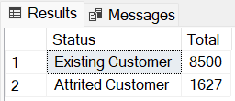
Query for Customer Segmentation by Status
A query to view the total number of customers categorised as Existing and Attrited status.
Segment by Status
-- select the database
USE CustomerHistoryData;
-- Segment by Status
SELECT Status,
COUNT(*) AS Total
FROM dbo.DataWarehouse
GROUP BY Status;

Slide 21
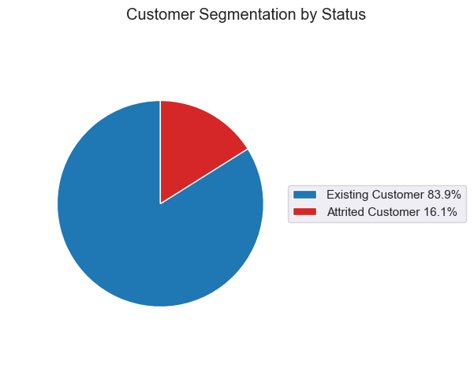
Visualization for Customer Segmentation by Status
Based on the available data, the number of existing customers appears to outweigh the number of attrited ones. This indicates that the business can retain its customer base and suggests a positive trend in customer loyalty. "Existing customers" refers to those currently conducting business with the company, while "attrited ones" refers to customers who have terminated their relationship with the company.

Slide 22
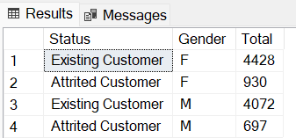
Query for Customer Segmentation by Gender
A query to view the total number of customers categorised by status & gender.
Segment by Status & Gender
-- select database
USE CustomerHistoryData;
-- segment by gender
SELECT Status,
Gender,
COUNT(*) as Total
FROM dbo.DataWarehouse
GROUP BY Status,
Gender;

Slide 23
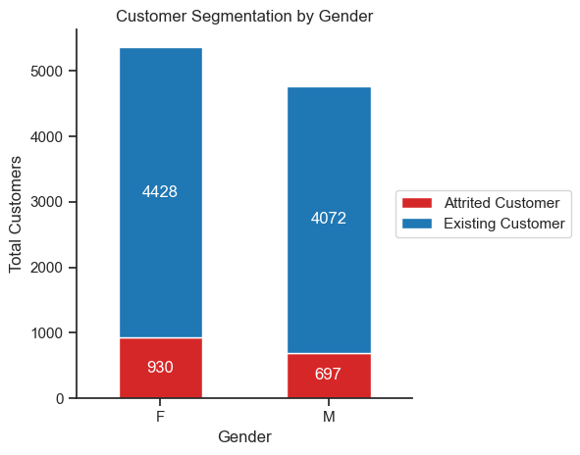
Visualization for Customer Segmentation by Gender
The available data shows that there are slightly more female customers than male ones, although the difference is not significant. This suggests the company's customer base is relatively evenly distributed between genders.

Slide 24
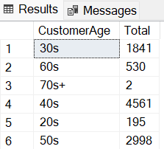
Query for Customer Segmentation by Age
A query to view the total number of customers categorised by age.
Segment by Age
-- select the database
USE CustomerHistoryData;
-- Segment by age
SELECT CustomerAge,
COUNT(*) AS Total
FROM dbo.DataWarehouse
GROUP BY CustomerAge;

Slide 25
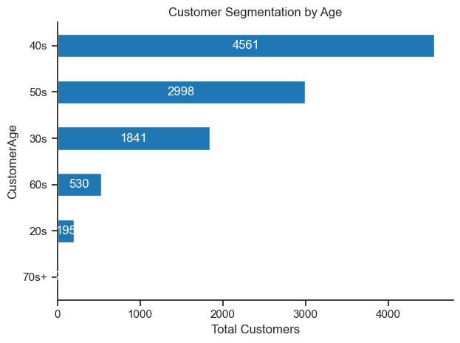
Visualization for Customer Segmentation by Age
Based on the available data, it appears that most customers fall within the age range of their 40s, while the smallest proportion is 70 years and above.

Slide 26
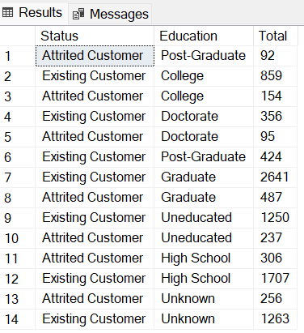
Query for Customer Segmentation by Education Level
A query to view the total number of customers categorised by status & education level.
Segment by Status & Education
-- select database
USE CustomerHistoryData;
-- segment by education
SELECT Status,
Education,
COUNT(*) as Total
FROM dbo.DataWarehouse
GROUP BY Status,
Education;

Slide 27
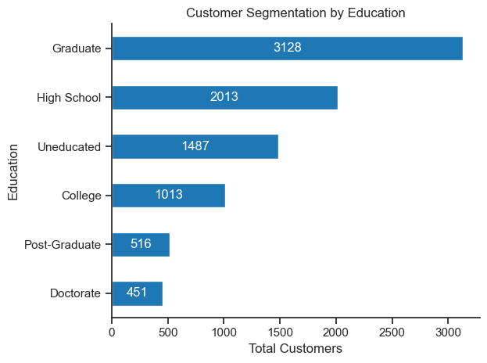
Visualization for Customer Segmentation by Education Level
Based on the available data, most customers hold a Graduate degree, while Doctorate degree holders are the smallest proportion among the customer base.

Slide 28
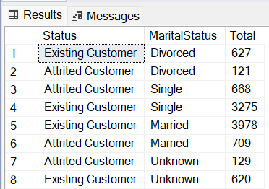
Query for Customer Segmentation by Marital Status
A query to view the total number of customers categorised by status & marital status.
Segment by Status & Marital Status
-- select database
USE CustomerHistoryData;
-- segment by marital status
SELECT Status,
MaritalStatus,
COUNT(*) as Total
FROM dbo.DataWarehouse
GROUP BY Status,
MaritalStatus;

Slide 29
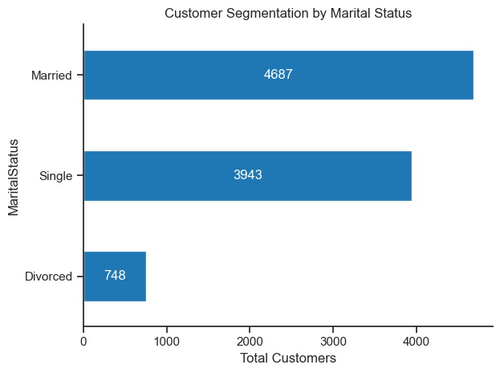
Visualization for Customer Segmentation by Marital Status
Based on the available data, it appears that the majority of customers are married, while the smallest proportion is divorced.

Slide 30
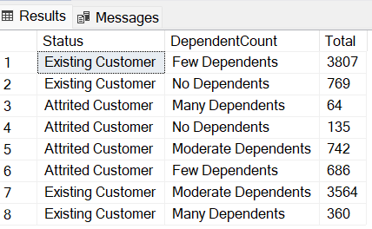
Query for Customer Segmentation by Number of Dependents
A query to view the total number of customers categorised by status & number of dependents.
Segment by Status & Number of Dependents
-- select database
USE CustomerHistoryData;
-- segment by number of dependents
SELECT Status,
DependentCount,
COUNT(*) as Total
FROM dbo.DataWarehouse
GROUP BY Status,
DependentCount;

Slide 31
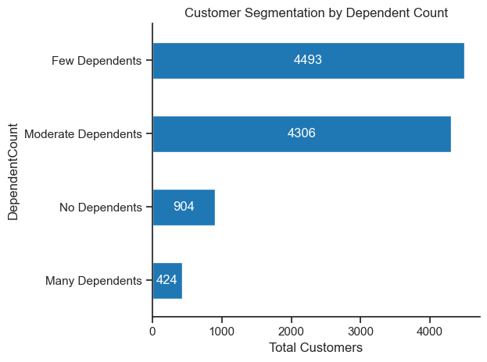
Visualization for Customer Segmentation by Number of Dependents
Based on the available data, most customers have few dependents, with 1 to 2 individuals, and moderate dependents, with 3 to 4 individuals.

Slide 32
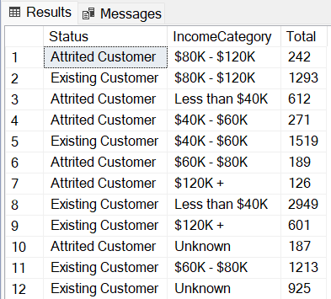
Query for Customer Segmentation by Income Level
A query to view the total number of customers categorised by status & income level.
Segment by Status & Income Level
-- select database
USE CustomerHistoryData;
-- segment by income
SELECT Status,
IncomeCategory,
COUNT(*) as Total
FROM dbo.DataWarehouse
GROUP BY Status,
IncomeCategory;

Slide 33
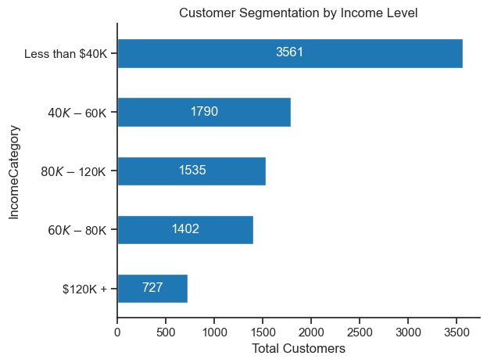
Visualization for Customer Segmentation by Income Level
Based on the available data, it appears that the majority of customers have an income of less than $40K, while the minority of customers have an income of above $120K.

Slide 34
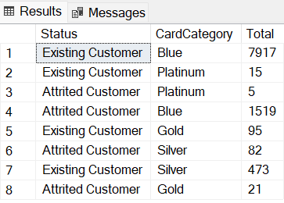
Query for Customer Segmentation by Card Category
A query to view the total number of customers categorised by status & card category.
Segment by Status & card category
-- select database
USE CustomerHistoryData;
-- segment by credit card
SELECT Status,
CardCategory,
COUNT(*) as Total
FROM dbo.DataWarehouse
GROUP BY Status,
CardCategory;

Slide 35
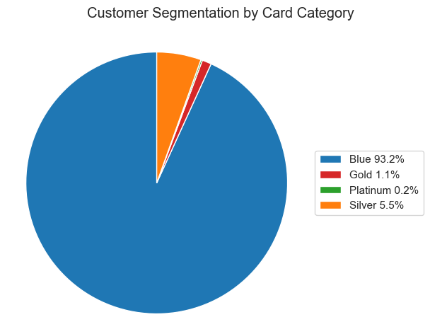
Visualization for Customer Segmentation by Card Category
Based on the available data, most customers have a Blue credit card, typically considered the entry-level credit card rank.

Slide 36
Summaries

Slide 37
Summaries
Based on the previous analysis, I can draw several conclusions:
Customer segmentation analysis has revealed notable characteristics of customers that stand out, including:
The majority of customers are existing ones, indicating high customer loyalty and retention.
The ratio of male and female customers is nearly equal
Most customers fall within their 40s, with a minor proportion of customers aged 70 years and above.
Most customers hold a Graduate degree, while Doctorate holders are a minor proportion.
Most customers are married and have few to moderate dependents.
Most customers have an income of less than $40K, with only a minority earning above $120K.
Lastly, the entry-level credit card rank, Blue, appears to be the most common credit card type among customers.

Slide 38
Recommendations

Slide 39
Summaries
Based on the previous conclusions, I can draw several recommendations:
For customer segmentation analysis:
Strengthen Customer Retention Programs: Since most customers are existing ones, it is essential to continue providing quality service and value-added benefits to retain their loyalty.
Target Specific Age Groups: The analysis showed that most customers are in their 40s, so the company should focus on tailoring marketing campaigns to this age group.
Increase Focus on Education and Career: As most customers hold a Graduate degree, the company can emphasise education and career-related benefits in its marketing efforts.
Develop Offers for Income Levels: Most customers have an income of less than $40K, so the company could create offers to this income bracket. However, the company should also consider developing offers for higher-income customers, as they represent a small but potential customer segment.
Expand Credit Card Offerings: While most customers hold a Blue credit card, the company could explore offering higher-level credit cards such as Gold or Platinum.

Slide 40
References

Slide 41
References
https://www.mssqltips.com/sqlservertip/6921/data-engineering-solution-python-sql-server/
https://www.dqlab.id/data-science-in-finance-credit-risk-analysis
https://www.shopify.com/id/blog/what-is-customer-segmentation
https://www.ibm.com/id-en/topics/etl
https://neptune.ai/blog/how-to-implement-customer-churn-prediction

Slide 42

Thank You!
E-mail: adrian.m.muhammad@gmail.com
Linkedin: linkedin.com/in/adrn-mm
Project: github.com/adrn-mm/final-project-VIX-DE-BTPN

